Slide 1
Prediction of Sepsis in the Intensive Care Unit With Minimal Electronic Health Record Data: A Machine Learning Approach
刘晓莉
2017.3.20

Slide 2
主要内容
期刊作者
背景及摘要
研究内容
结果与分析
讨论与结论
对比思考

Slide 3


期刊作者
JMIR (Journal of Medical Internet Research)
HEALTH CARE SCIENCES & SERVICES (医院管理) 排名第 2 位 ；
MEDICAL INFORMATICS (医学信息) 排名第 1 位 .
Thomas Desautels
Senior Engineer (Biomedical and Machine Learning R&D)
A machine-learning software system for detection of sepsis and septic shock in ICU

Slide 4
背景及摘要
Sepsis
由感染所致的全身炎症反应综合征
机体感染后产生的失控反应所导致的危及生命的器官功能障碍
Sepsis 1.0
Infection + SIRS
Sepsis 3.0

Slide 5
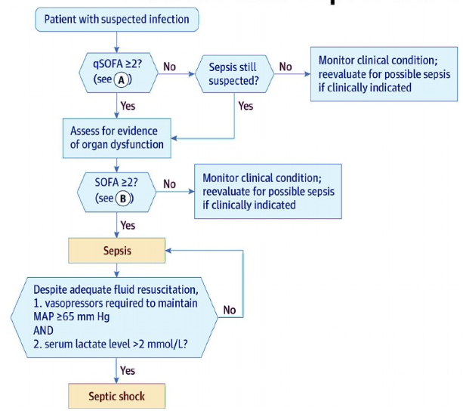
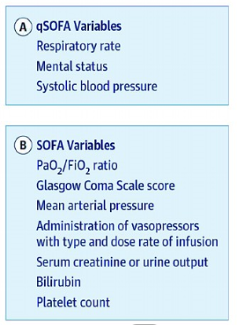
Notes:
http://wenku.baidu.com/view/c358f96202d276a201292e4b.html 序贯器官衰竭估计评分(SOFA)

Slide 6
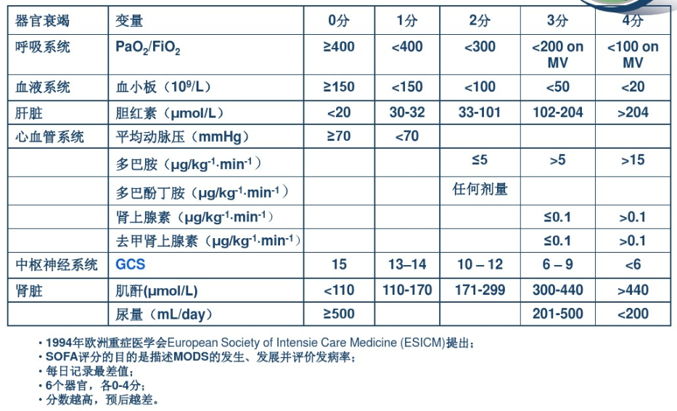
Notes:
http://wenku.baidu.com/link?url=c0MtqWT7NXDllMM3ozeAt_o-nbSBZcbS61fQF4vQncSfwe0dzNG_CnCF5fX8RkDolxeX7rPMtSsOUUutZLZVng2JGD153ZH1G8c8A51kNY3

Slide 7
背景及摘要
Study, validate a sepsis prediction method —— InSight
InSight (machine learning classification system )
Contain: vitals, SPO2, GCS, and age (easily obtain)
MIMIC-III (Multiparameter Intelligent Monitoring in Intensive Care) + Sepsis-3
Results
1 ~ 4 h preceding sepsis onset
AUROC = 0.88 (SIRS = 0.609, qSOFA:0.772, MEWS:0.803, SAPS II:0.7, SOFA = 0.725)
Delete 60% data —— good robustness (AUROC = 0.781 )

Slide 8
研究内容
数据集准备
数据提取和插补
金标准
临床测量选择和病人纳入
机器学习算法
设计实验
评估时间性能
测试数据缺失性能
Notes:
细菌侵入血液循环，血培养阳性，则称为菌血症(bacteremia)。脓毒症和菌血症常继发于严重创伤后的感染和各种化脓性感染，致病菌种繁杂、数量多、毒力强。
脓毒症就是通常所称的「败血症」，是急性感染加重的常见最终发展结果。
在抗菌药物治疗前需进行血（或其他体液、渗出物、脓液）培养，分离得到致病菌后作药敏试验，才能根据病原菌及药敏结果选择敏感抗菌药物进行病因治疗。细菌在培养基中生长需要一定的时间，如果有细菌生长一般 3 天会报阳性，如果 3 天仍无细菌生长，会继续培养 1 周，仍无细菌生长，则为阴性。血培养阳性率较低，所以通常会对病人进行多次血培养检查，以提高阳性率。

Slide 9
研究内容 — 数据集准备
数据提取和插补
MIMIC-III (PostgreSQL + Matlab)
A bin width of one hour (average)
Missing data are imputed using a “carry-forward” system (most recent bin value)

Slide 10
研究内容 — 数据集准备
金标准
Life-threatening organ dysfunction caused (dysregulated host response to infection)... an acute change in total SOFA score ≥2 points consequent to the infection ( Singer et al)

Slide 11
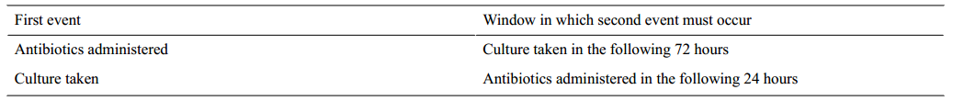
研究内容 — 数据集准备
Infection
A culture lab draw together with a dose of antibiotics(within a specified window)

Slide 12
研究内容 — 数据集准备
SOFA
≤48 h
24 h
未出ICU
数据记录
Sofa₁
Infection
Sofa₂ - Sofa₁ ≥ 2 (Sepsis)

Slide 13
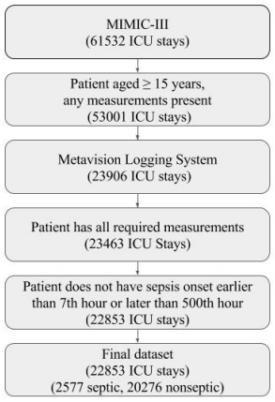
研究内容 — 数据集准备
临床测量选择和病人纳入
SBP, PP, HR, RR, T,SpO2, AGE, GCS
MIMIC-III
age ≥ 15
Metavision
all measurements (need)
sepsis (7 h ≤ ≤ 500 h )

Slide 14
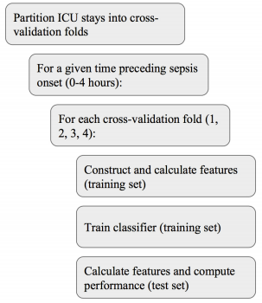

研究内容 — 机器学习算法
Data partitioning
4 folds for cross-validation
Feature construction
Classifier training
Classifier testing

Slide 15
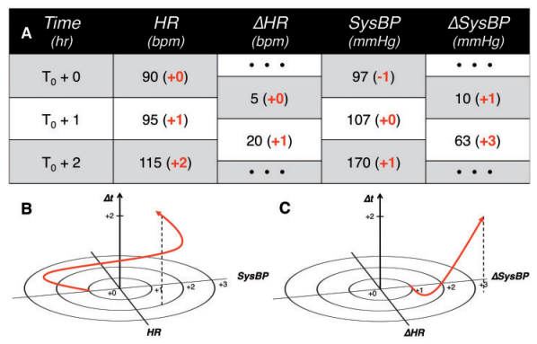
研究内容 — 机器学习算法
Sepsis (s = 1)
Stability Score =
Notes:
AUROC max （standard optimization technique）

Slide 16
研究内容 — 设计实验
0, 1, 2, 3 and 4 h (before sepsis)
Compare with qSOFA , MEWS, SIRS, SOFA, SAPAS II
Random delete P (P = {0, .1, .2, .4, .6})

Slide 17
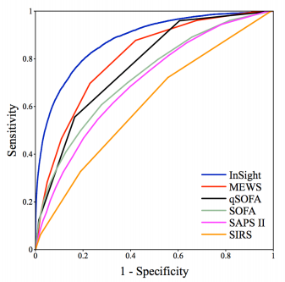
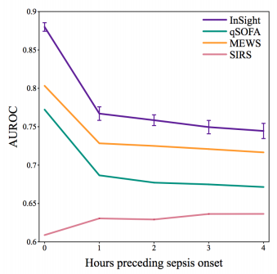
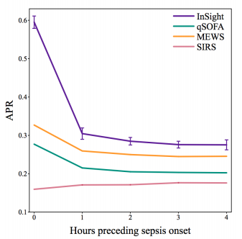
结果与分析
the InSight ROC curve generally shows higher sensitivity or specificity
Notes:
https://www.douban.com/note/518998773/
在正负样本分布不均匀下，precision-recall curv 比 ROC更能反映分类器的效果。

Slide 18
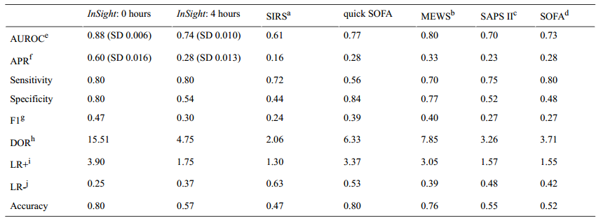
结果与分析
Notes:
https://www.douban.com/note/518998773/
在正负样本分布不均匀下，precision-recall curv 比 ROC更能反映分类器的效果。

Slide 19
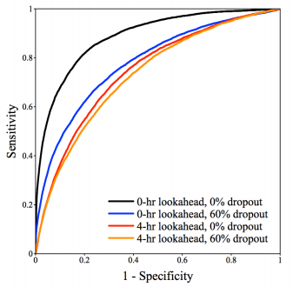
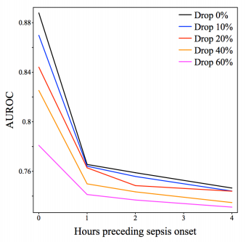
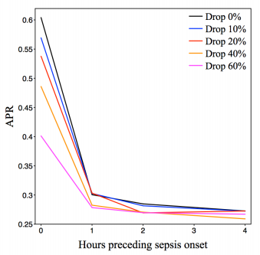
结果与分析
InSight 4-hours ahead and with (60% missing) achieves performance similar to qSOFA detection with no dropout.

Slide 20
讨论与结论
Principal Findings
Commonly available and are easily assessed at the bedside (performance superior)
Nearly any specified sensitivity, superior specificity , and vice versa
Learns patterns in the trends and correlations among extended vitals
Experiments to be relatively resistant ( loss availability )
Plan to integrate of the InSight algorithm in an ICU setting

Slide 21
讨论与结论
Limitations
Not design a manual scoring system , but an automatic EHR-integrated system
Gold standard : Sepsis onset is a poorly defined event
identification of an onset time
Metavision system( suspected infection ) no CareVue system
A single center( generalization )

Slide 22
讨论与结论
Conclusion
Use simple and readily available patient dataside (performance superior SPAS II/SOFA)
Without requiring the laboratory tests (machine learning methods)
Learns patterns in the trends and correlations among extended vitals
Resistant to performance degradation (significant random data deletion)
Applicable autonomously in an EHR-integrated environment and offers a
high-performance alternative (without any additional data)

Slide 23


对比思考
 | TREWScore | InSight
Target | Septic shock | Sepsis
Database/Definition | MIMIC-II Sepsis 1.0 | MIMIC-III Sepsis 3.0
Features | vital / lab/ SOFA, SIRS (54个-26个) | SBP, PP, HR, RR, T,SpO2, AGE, GCS
Method
Performance | 28.2 h ROC 0.83(MEWS/RSP) | 4 h ROC 0.88 (qSOFA , MEWS, SIRS, SOFA, SAPAS II)

Slide 24
对比思考
特征选取 (Easily、Trend、Interaction)
预测的方法
插值的方法
Septic shock预测时间，效果？
一位患者 BIDMC → 301 ?

Slide 25
Thanks!

Slide 26
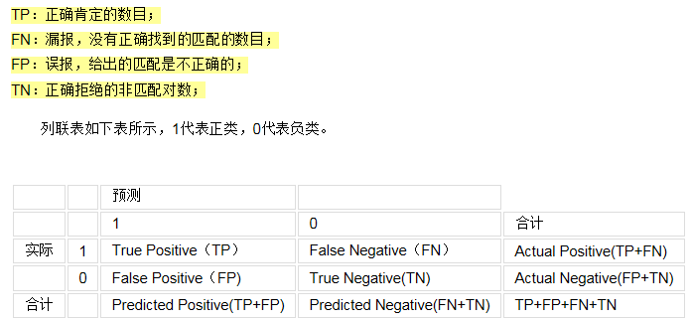
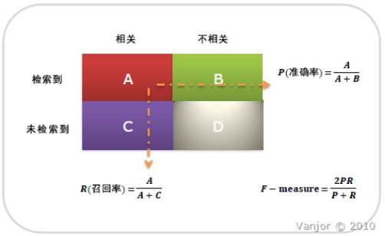
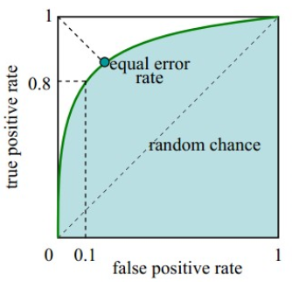
Receiver Operating Characteristic(接受者操作特性曲线)
1-specificity (x)
Sensitivity (y)

